Slide 2

Ephesians 4:17-24

Slide 3
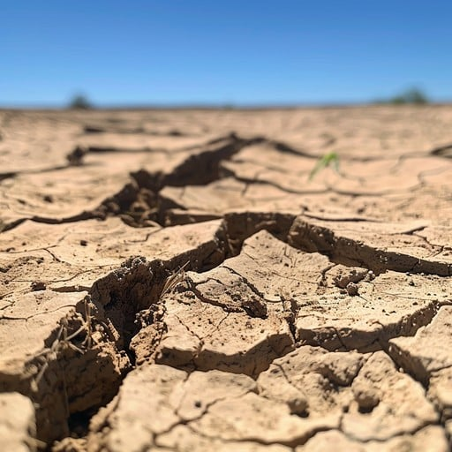
DRY CRACKING GROUND
Hardening – [things] being rigid, inflexible, unlimber or stony.
Hardening – [people] being stubborn, unyielding, past feeling.

Slide 4

Implies An Irrevocable Commitment

Slide 5
Most serious type of hardening is that of the heart
Pharaoh – Exodus Chapters 7-14
Israel – Hebrews 3:8-19
US – Hebrews 6:4-8
We may wander so far that our disposition to return is destroyed --- THE POINT OF NO RETURN!
Proverbs 28:14 “But he who hardens his heart will fall into calamity.”

Slide 6
What happens when the heart is hardened?
Pharaoh Against God!
Men Today Harden Their Hearts:
  Against influences of truth
  Against the pricking of conscience, reproof and encouragement of friends, family and God – the WORD
  The Word loses all effect!
Remember shortly after conversion when we erred?

Slide 7
What happens when the heart is hardened?
The heart parts with important characteristics
  It loses its susceptibility to truth, spiritual feeling, a sense of shame, sensitiveness to good influences and opportunities, feelings of right and wrong.
  They become mere animals – Romans 1:21 “because, although they knew God, they did not glorify Him as God, nor were thankful, but became futile in their thoughts, and their foolish hearts were darkened.”

Slide 8
What happens when the heart is hardened?
The heart hardens itself in some evil qualities:
  Indifference, lust, hate, greed, cruelty, injustice
  More sin leads to more sin as one lie leads to another
  Sin causes less grief as indulged in more freely
  Go from being overtaken in a fault (Galatians 6:1) to overtaking the fault and running after sin as a criminal!

Slide 9
What happens when the heart is hardened?
It Is A Sad Condition
  Talk of sin lightly
  Make excuses for sin
  See it in others without sorrow
  See it in “self” without shame!
  Tell self that all is well; they whisper "Peace, peace, when there is no peace." (Jeremiah 6:14)

Slide 10
What happens when the heart is hardened?
The Deceitfulness of Sin Allowed To Take Over – Hebrews 3:13
  Frog boiled slowly over low heat will boil to death
  Sin does not tell of ultimate consequences!
  Drunkard does not hear the warnings of liver and brain damage
  Smoker refuses to hear the warnings of cancer and other disorders
  The SINNER refuses to hear about the coming judgment of God! Romans 6:23; 2 Corinthians 5:10

Slide 11
What happens when the heart is hardened?
Sin does not tell of dulling effect on conscience and character
  "I'll never do this again!" (again and again)
  See Sin in an elder or preacher, but not in “self!”
  “My youth excuses me!”
  We need to learn to flee sin like a contagious disease! 2 Timothy 2:22 “Flee also youthful lusts”

Slide 12
What is god’s part in the hardening process?
Permits evil to exist and run its whole course to show what it really is – 1 Corinthians 5:5
MAN, not GOD is RESPONSIBLE – James 1:13-15
God uses even evil agents to fulfill His purpose
  Pharaoh
  High Priest Caiaphas- John 11:49,50
  Judas Iscariot

Slide 13
How is the point of no return reached?
Not taking heed – Hebrews 3:9 “And saw My works forty years.”
Never intended to become alcoholic or wind up in prison
Yielding to Adultery can lead to DIVORCE! Matthew 19:8
Romans 1:24,26 “God also gave them up to uncleanness, in the lusts of their hearts” “God gave them up to vile passions”
Dress and Speech –Genesis 3:21; Matthew 12:36,37
Willing Refusal – Hebrews 6:4-8

Slide 14
How is the point of no return reached?
Compromise:
  Doing Only Part of What is Asked – Exodus 8:25,28; 10:11,24
  Insincere repentance – Exodus 9:27 “I have sinned this time.”
  John the baptist – Matthew 3:8 “Therefore bear fruits worthy of repentance.”

Slide 15
The point of no return looms near when:
We are content with NOMINALITY- Revelation 3:1
Thinking Attendance or Giving Make up For Real Commitment and Personal Service!
Start Looking For The Easy Life – Matthew 25:29
NOMINALITY causes people to not develop their abilities!

Slide 16
The point of no return looms near when:
Treat Sin “Professionally” - They lose the dread of evil; take sin as matter of course because they deal with it so often!
Hardness is also the result of delay
Dangerous to hear a sermon and ignore it!

Slide 17
What happens when the heart is hardened?
There is something the heart resists
Things the heart parts with
Things the heart becomes!
The deceitfulness of sin is allowed to take over!
In the process God simply permits evil to run its course and uses evil agents to fulfill His purpose.

Slide 18
There is still hope for you and me
God is Merciful – 2 Peter 3:9
We need SPIRITUAL HEART SURGERY- Ezekiel 11:19 “take the stony heart out … give them a heart of flesh.”
We need a heart Filled with Faith and Eyes Filled With Tears of Repentance- 1 Peter 1:6,7; 2 Corinthians 7:10
Loving works of obedience are inseparably connected to Faith and Repentance by words of inspiration – Acts 2:38; James 2:24
Faltering Christian – Galatians 5:4; Acts 8:22,23
Jeremiah 8:20 “harvest is past” “And we are not saved!”

